Slide 1

How to fill the request form travel and accommodation expenses and upload it to ValidSign to get is signed

Slide 2
Step 1 Getting the form (as XLSX)
Go to the ICS website https://intranet.uu.nl/en/ICS/travel-request and find the Travel Application form.
Download it to your pc and open the file
Note: only fill the yellow-colored fields and leave the other ones: the signature and signature date fields are set up to automatically be created when uploading the final PDF to ValidSign.

Slide 3
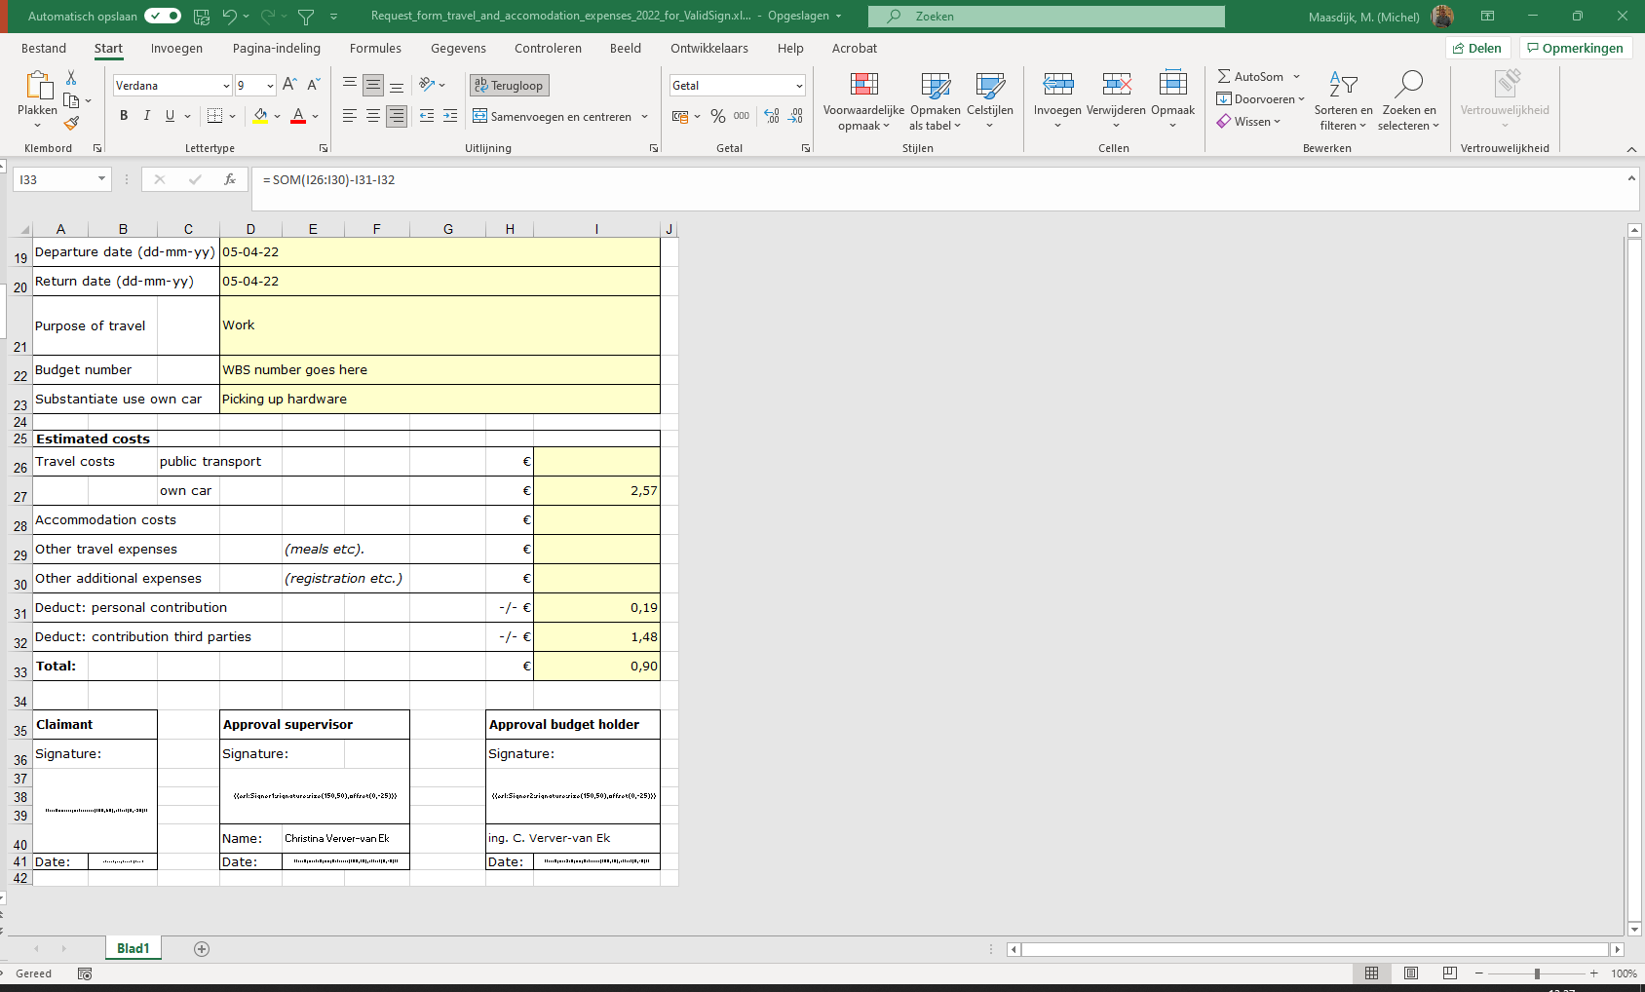
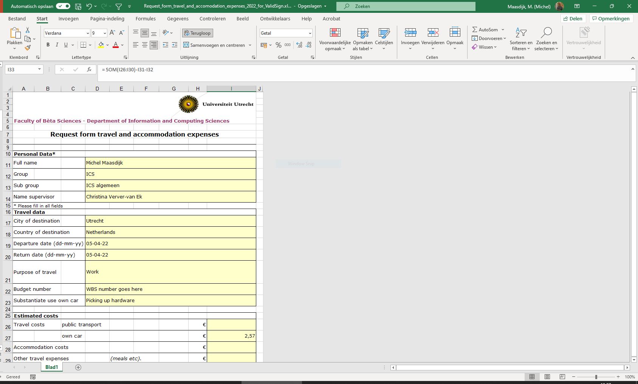
Step 2 Fill in the form
Just fill in the costs and contributions. The Total will be calculated
The name of the supervisor will be filled based on the cell value “Name supervisor”

Slide 4
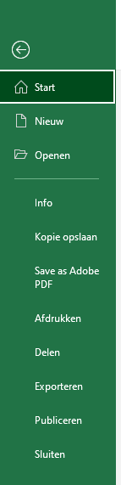
Step 3 Save the form
After filling in the form, the applicant can save the Excel as a PDF from the menu (Save a copy, Save as or Save as Adobe PDF).

Slide 5
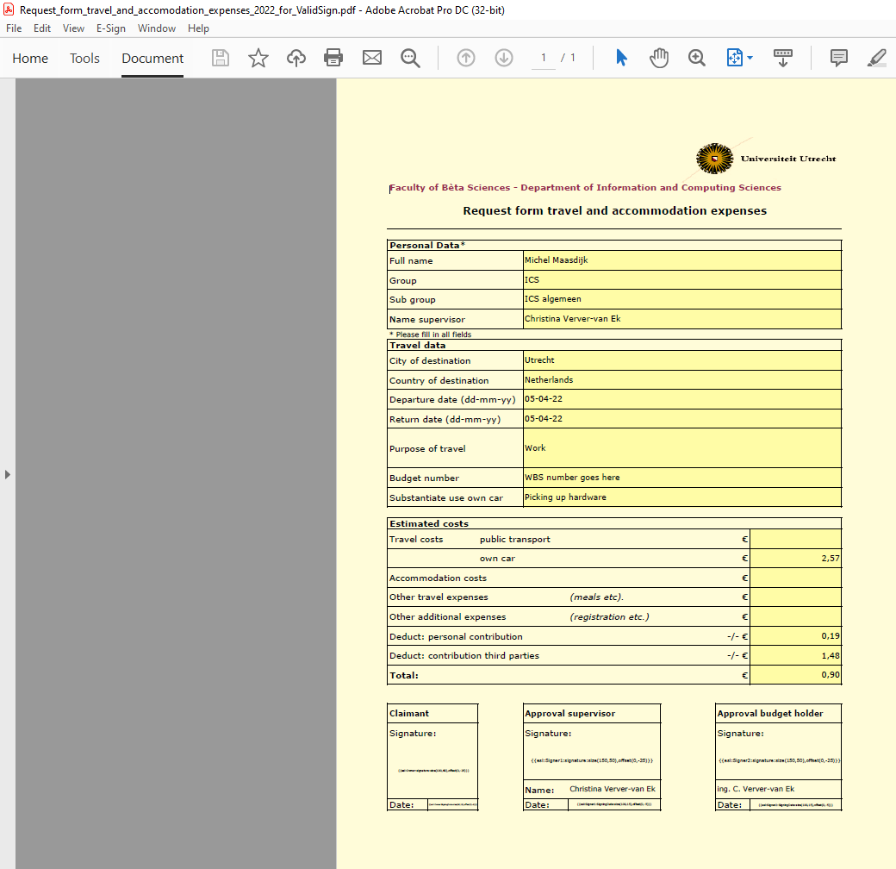
Step 3
Please check if all codes are on one line

Slide 6
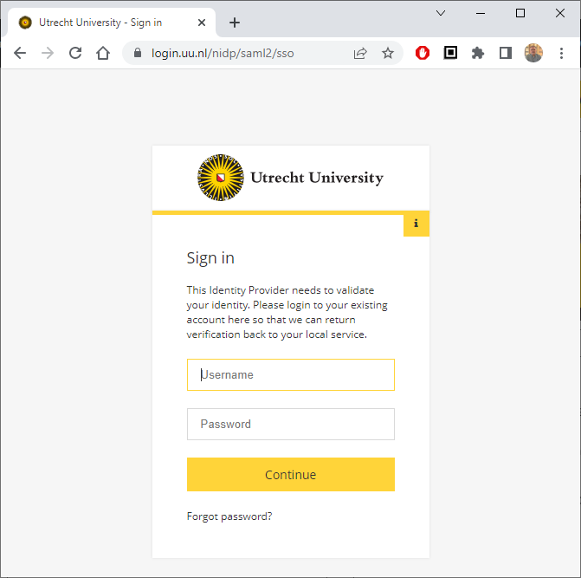
Step 4 Upload for signing
After the PDF is created, please open your browser and type in the following address in the address bar:
https://signature.uu.nl
You will be asked to login using your Solis-id
and 2FA.

Slide 7
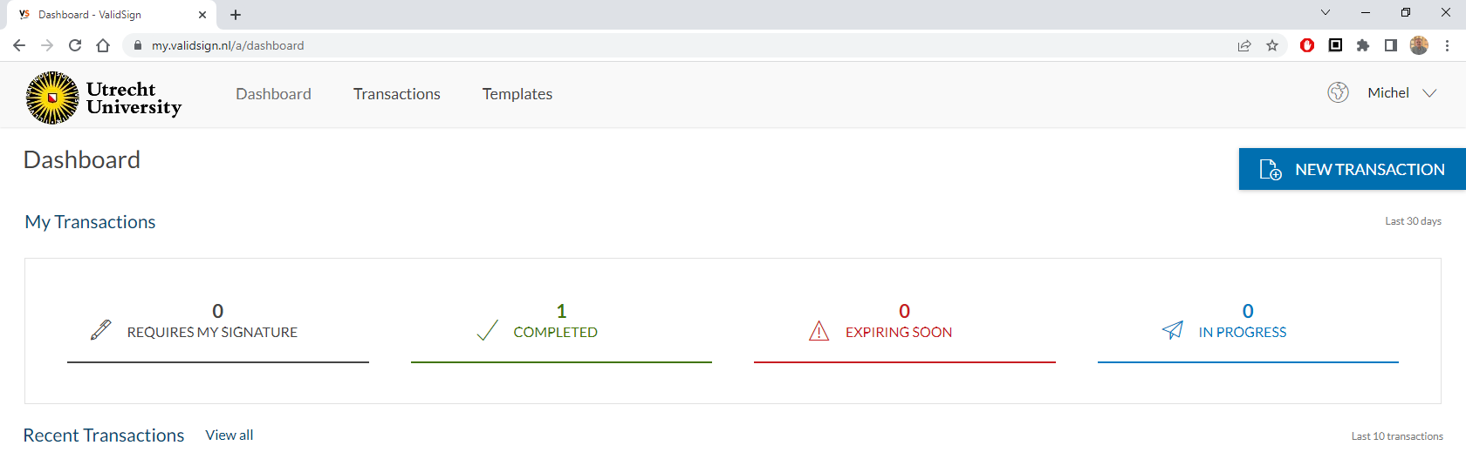
Step 4 Upload for signing
After logging in you will be redirected to your dashboard.
Click on NEW TRANSACTION

Slide 8
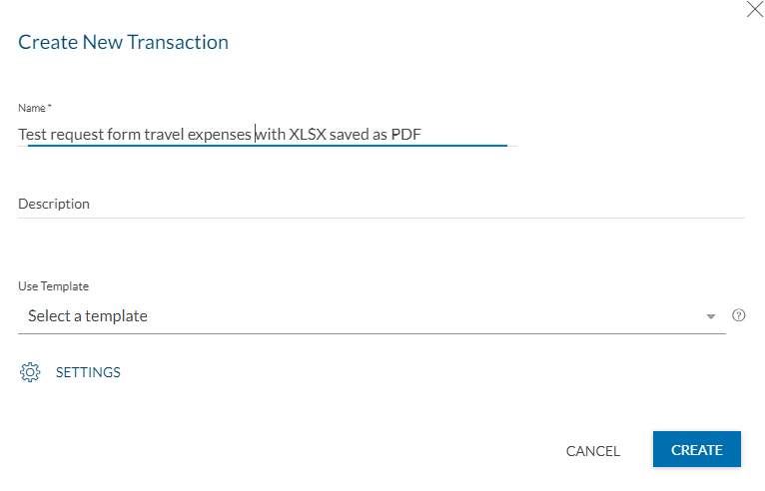
Step 4 Upload for signing
Fill in the name for your application form and click CREATE

Slide 9
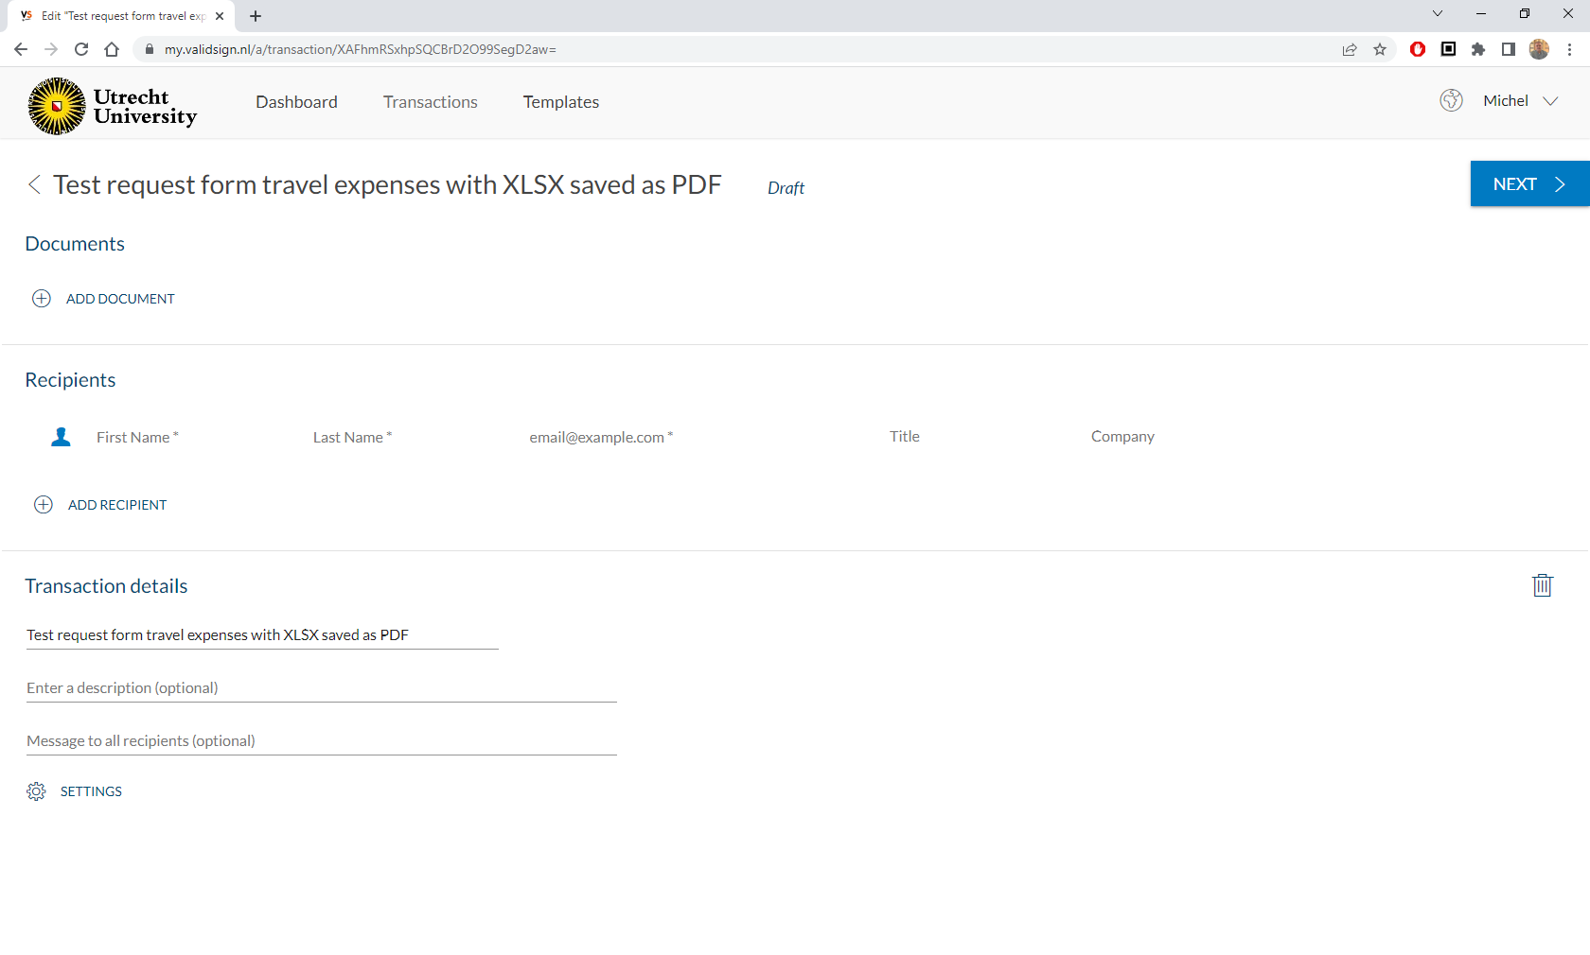
Step 4 Upload for signing
In the next window click ADD DOCUMENT

Slide 10
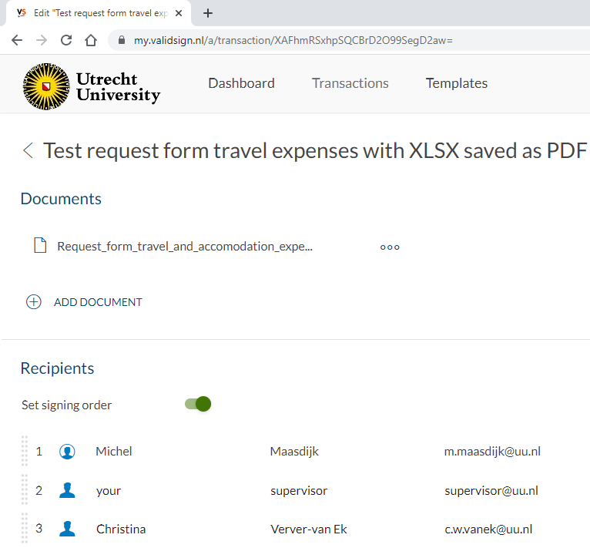
Step 4 Upload for signing
After uploading the document, your name will be added to the recipients list. Now add 2 more recipients:
Your supervisor
Christina Verver-van Ek
Make sure Set signing order is turned on then click NEXT

Slide 11
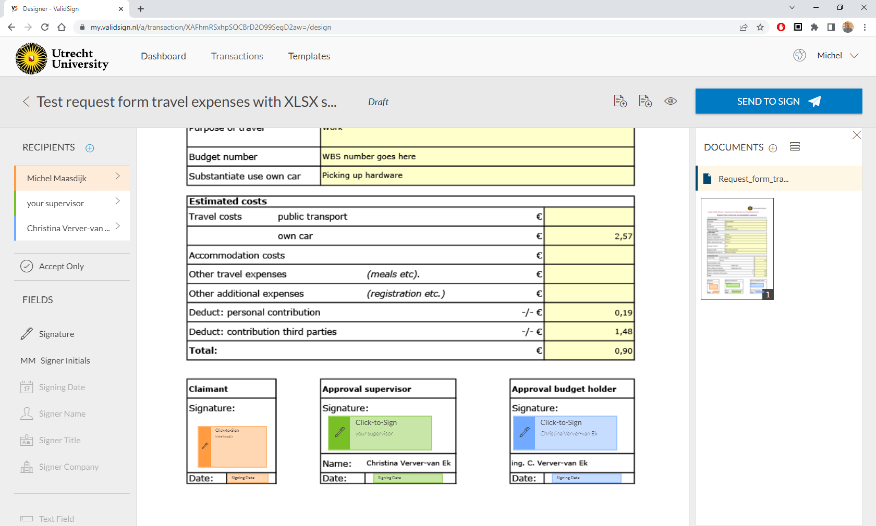
Step 4 Upload for signing
Now check if all recipients show correctly, then check if all fields are placed correctly. If they are: click the SEND TO SIGN button. In the pop- up confirm you want to send it and start signing first.

Slide 12
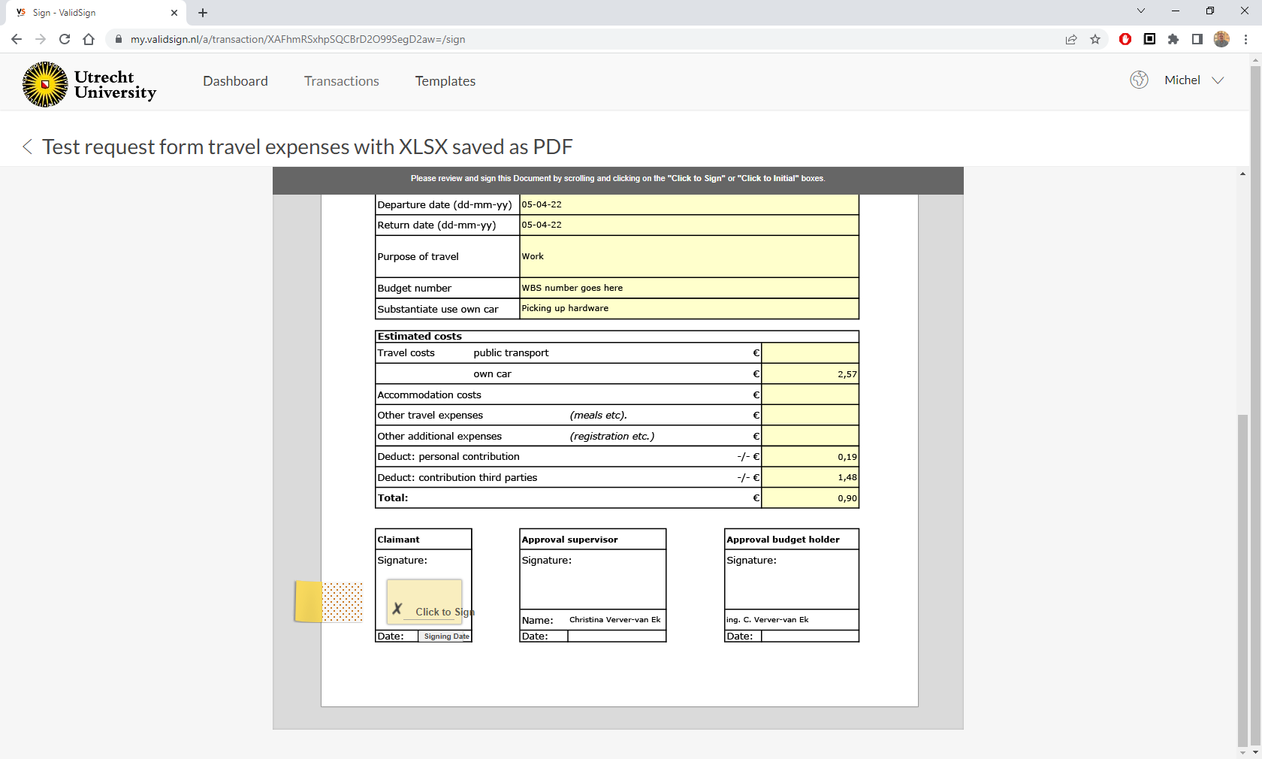
Step 5 Signing
You just have to click the Click to Sign button. The Signing Date field will be filled automatically. After you have clicked, you can confirm or review the document. If you confirm, the next recipient will be notified.

Slide 13
Step 5 Signing
When everyone has accepted the application form, an email will be send to all signers.
The transaction can be found under Dashboard or under Transactions.
Note: completed transactions will be deleted after 90 days, so archive a copy in your UU OneDrive.

